Slide 1
Agenda
Time | Topic | Presenters
01:00PM – 01:30PM | Using Flux to overcome scheduling challenges of exascale workflows | Dong H. Ahn
01:30PM – 01:45PM | Fully Hierarchical Scheduling and Job Interfaces for Large Ensembles of Uncertainty Quantification (UQ) Tasks | James Corbett
01:45PM – 2:00PM | Flux’s job and resource model | Stephen Herbein
2:00PM – 2:15PM | Play the full game! | Dan Milroy
2:15PM – 3:00PM | Example/Use-case driven hands-on session | Herbein/Tapasya
03:00PM – 3:30PM | Bring Your Own Cluster (BYOC): Testing Flux on your clusters | All
Note: All tutorial slides and demo content are available on Github: https://github.com/flux-framework/Tutorials/tree/master/2021-ECP

Slide 2
Using Flux to overcome scheduling challenges of exascale workflows
Flux Tutorial at ECP Annual Meeting, April 14, 2020
Dong H. Ahn
Acknowledgment: Ned Bass, Subhendu Behera, Albert Chu, Kyle Chard, Brandon Cook, James Corbett, Ryan Day, Franc Di Natalie, David Domyancic, Phil Eckert, Stephen Herbein, Jim Garlick, Elsa Gonsiorowski, Mark Grondona, Helgi Ingolfsson, Shantenu Jha, Zvonko Kaiser, Dan Laney, Carlos Eduardo Gutierrez, Edgar Leon, Don Lipari, Daniel Milroy, Joseph Koning, Claudia Misale, Chris Moussa, Frank Muller, Tapasya Patki, Yoonho Park, Luc Peterson, Barry Rountree, Thomas R. W. Scogland, Becky Springmeyer, Michela Taufer, Jae-Seung Yeom, Veronica Vergara and Xiaohua Zhang

Slide 3
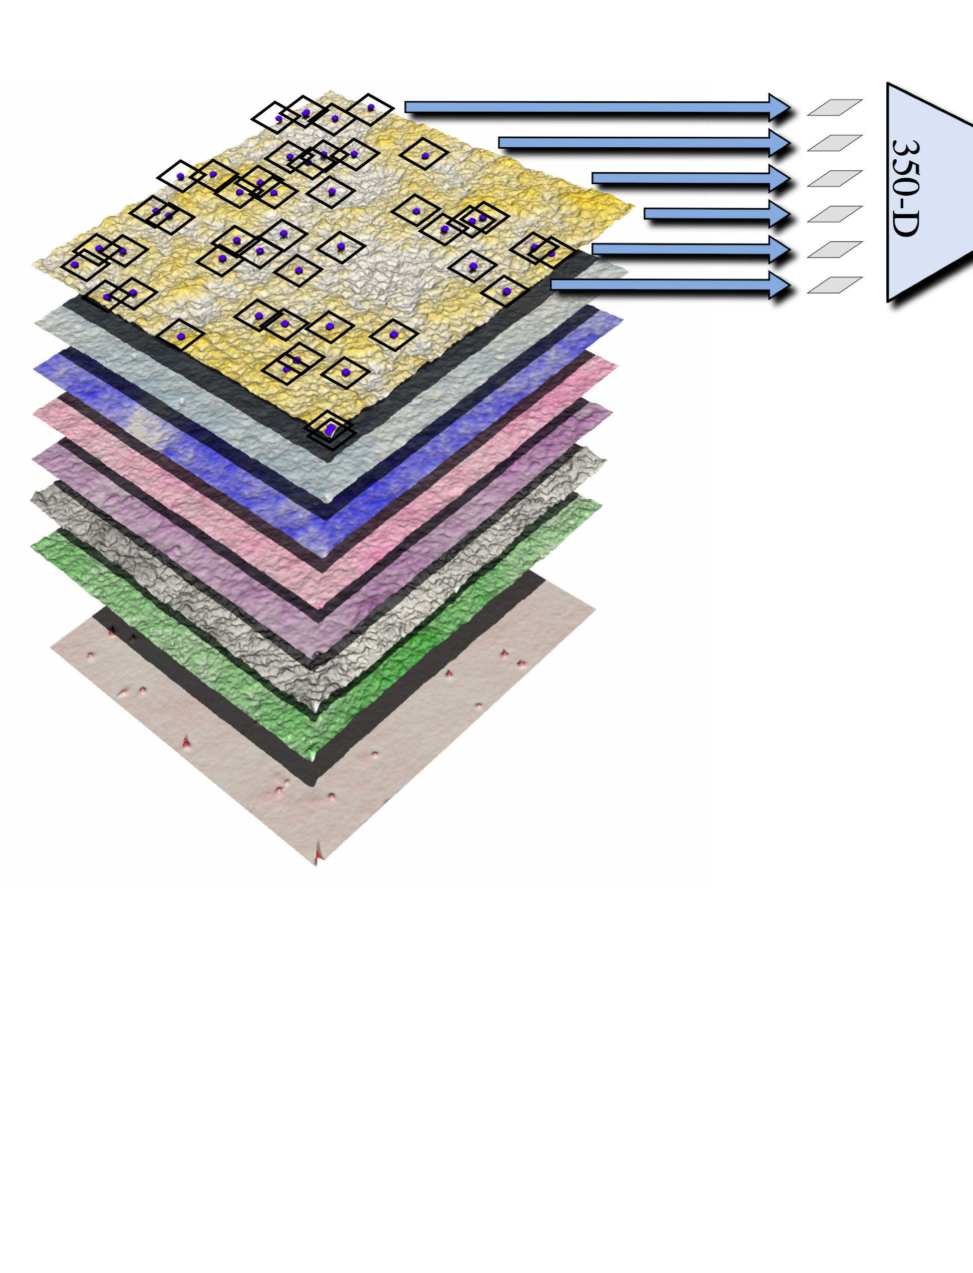

Sierra pre-exascale system is a wakeup call (MuMMI).
CG Setup
Python; Custom; GROMACS
24 CPU cores each 1.5 hr each
…
ML-based Selection
Python; ML frameworks; FAISS
24 CPU cores >1000 decisions per minute
FIFO; real-time tracking & update
…
Single Macro Simulation
C++ (with MPI); MOOSE; ddcMD
24 CPU cores/node; 2400 MPI tasks
242 GB per day
Analysis Aggreg. & Feedback
Python; Custom
24 CPU cores 120,000 reads per cycle
CG Simulation
C++ (with CUDA); ddcMD
1 GPU + 1 CPU core each 1.04 μs and ~6.5 GB per day
In situ CG Analysis
Python; Custom
3 CPU cores each >2K frames per day
Notes:
Our strategy has been centered around Flux
Next-generation resource management and scheduling framework project
NGCE is responsible for advanced scheduling R&D and workflow co-design aspect of Flux
LC as a whole is behind the development of Flux

Slide 4
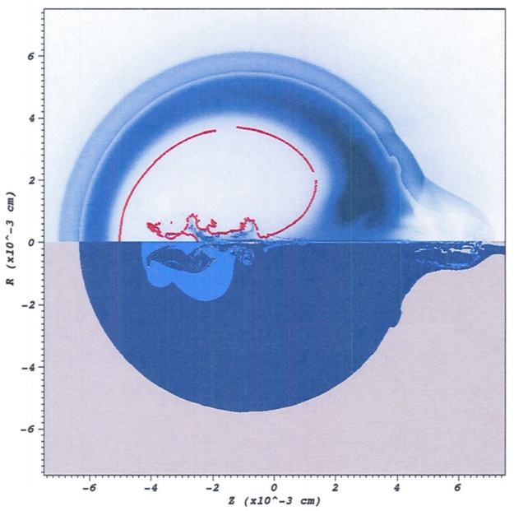

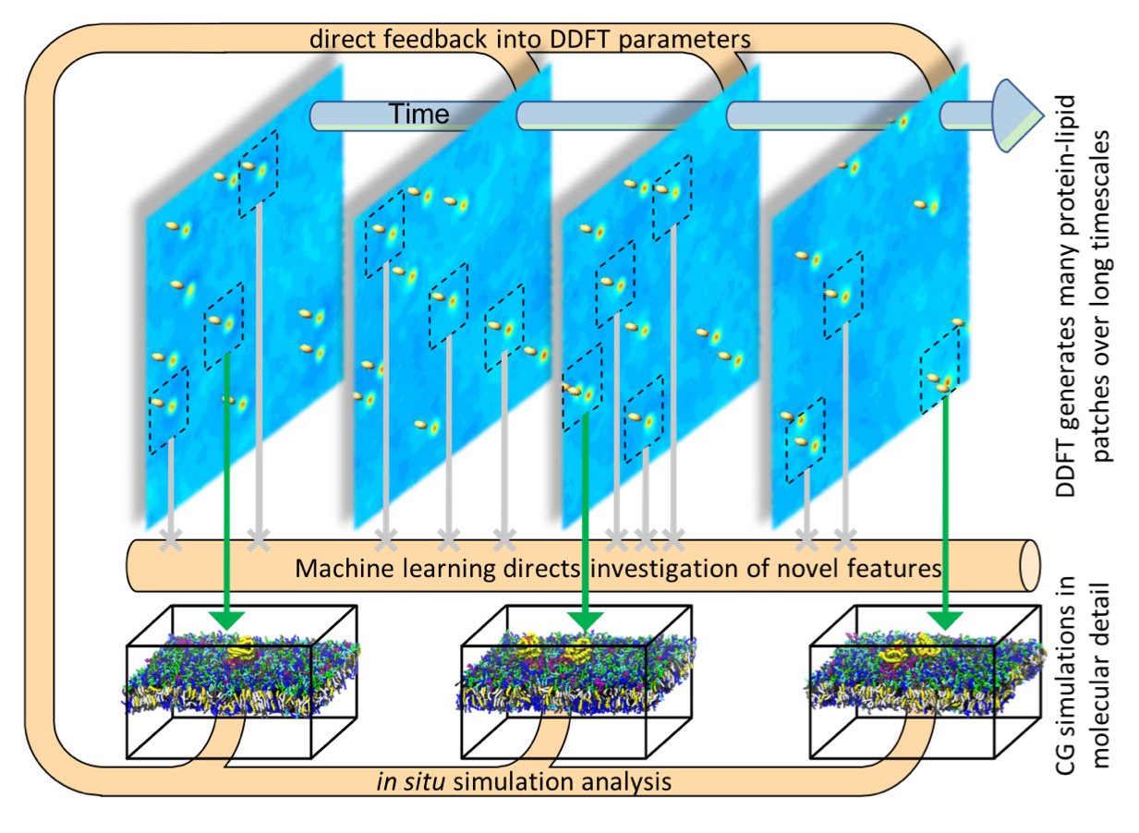

Key challenges in emerging workflow scheduling include…
New pillar
Co-scheduling challenge
Job throughput challenge
Job communication/coordination challenge
Portability challenge

Slide 5

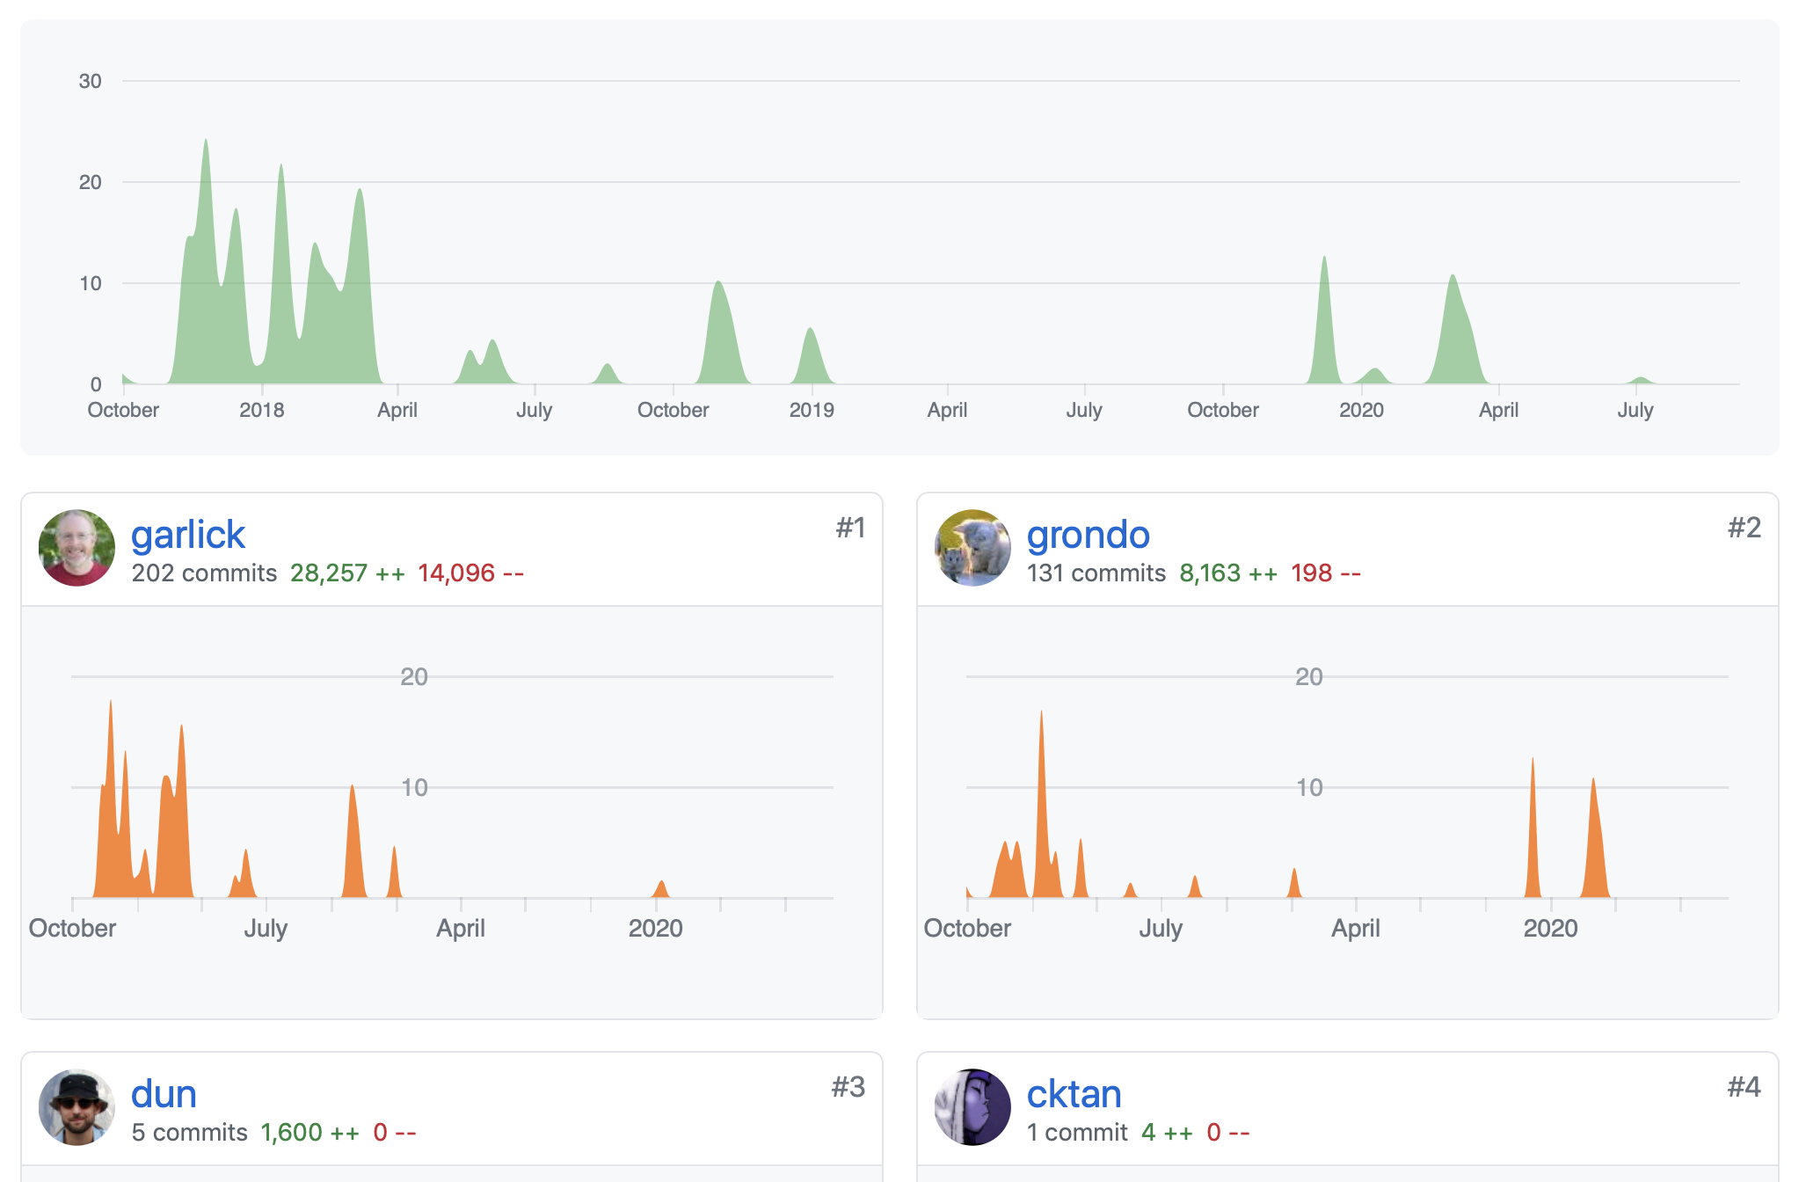

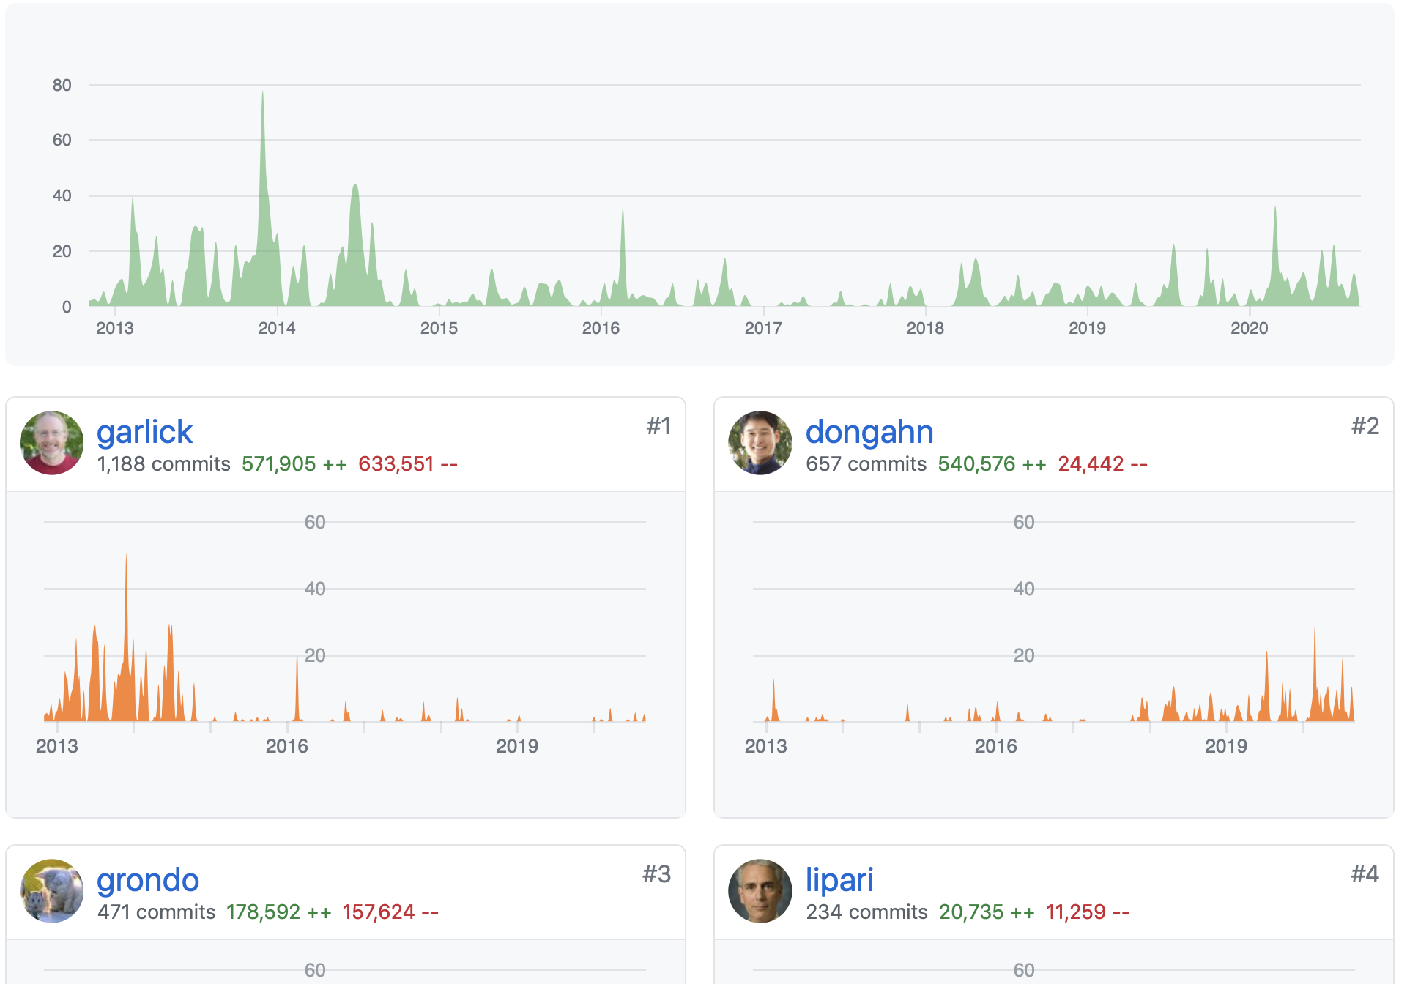

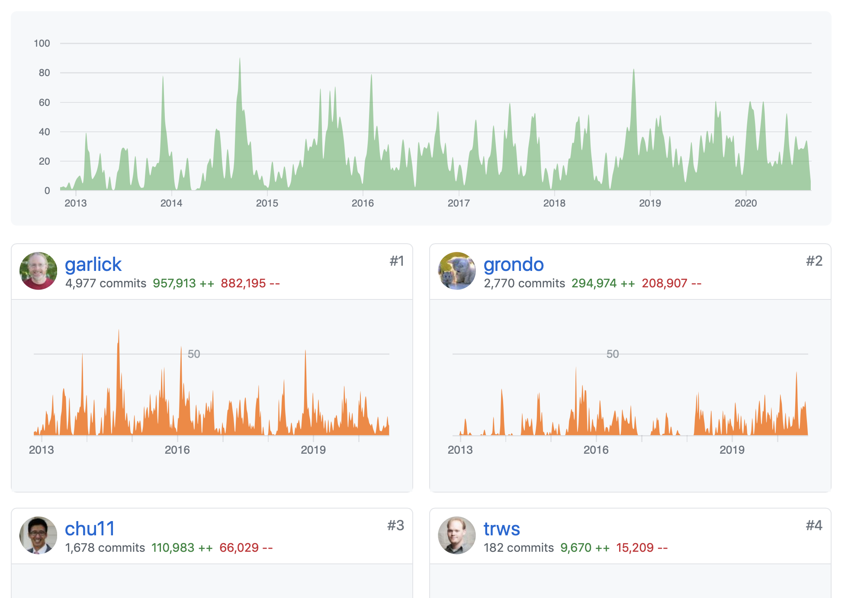

at a glance
Open-source project in active development at flux-framework GitHub organization
Composed of multiple projects: flux-core, -sched, -security, -accounting etc
Over 15 contributors including some of the principal engineers behind SLURM
Single-user and multi-user (a.k.a. system instance) modes
Single-user mode has been used in production for ~3 years
Multi-user mode is having its debut on LLNL’s Linux clusters
Plan of record for LLNL’s El Capitan exascale system

Slide 6
Flux offers a new scheduling model to meet modern-day workflow challenges.
Allocated Resources
Native support for seamless nesting
Users don’t need to wait for the facility to deploy Flux as the system resource manager and scheduler to benefit from it!
Your personalized Flux instances provide ample opportunities for you to tailor Flux to your unique resource and job management needs.
Rich and well-defined interfaces facilitate easy software composition.
Flux Instance
Depth-1
Node
Node
Node
Node
Flux Instance
Flux Instance
Flux Instance
Flux Instance
Depth-2
C
C
C
C
C
C
C
C
C
C
C
C
C
C
C
C
C
C
C
C
C
C
C
C
C
C
C
C
C
C
C
C
Depth-3
C
C
C
C
C
C
C
C
C
C
C
C
C
C
C
C
C
C
C
C
C
C
C
C
C
C
C
C
C
C
C
C
Our “fully hierarchical model” is designed specifically to meet
modern-day workflow needs.

Slide 7
Flux is architected to embody our fully hierarchical scheduling model seamlessly.
Techniques
Challenges
Job Queue
Co-scheduling challenge
Job throughput challenge
Job communication/coordination challenge
Portability challenge
A
B
C
D
E
F…
Scheduler Specialization
Scheduler Parallelism
Rich API set
Consistent API set
Flux framework

Slide 8
Scheduler specialization solves the co-scheduling challenge.
Traditional approach
A single site-wide policy being enforced for all jobs
No support for user-level scheduling with distinct policies
Flux enables both system- and user-level scheduling under the same common interfaces.
Give users freedom to adapt their scheduler instance(s)
Instance owners can choose predefined policies different from system-level policies.
Queuing policies (e.g., FCFS or backfilling-capable policies) and other parameters (queue depth, reservation depth etc) to allow for trading-off between performance and effectiveness
Resource match polices
Policies to control the flux instance hierarchy topology
Create their own policy plug-in
$ salloc -N4 –ppdebug
salloc: Granted job allocation 5620626
$ export FLUXION_QMANAGER_OPTIONS=queue-policy=easy
$ srun -N ${SLURM_NNODES} 4 -n ${SLURM_NNODES} --pty --mpi=none flux start

Slide 9
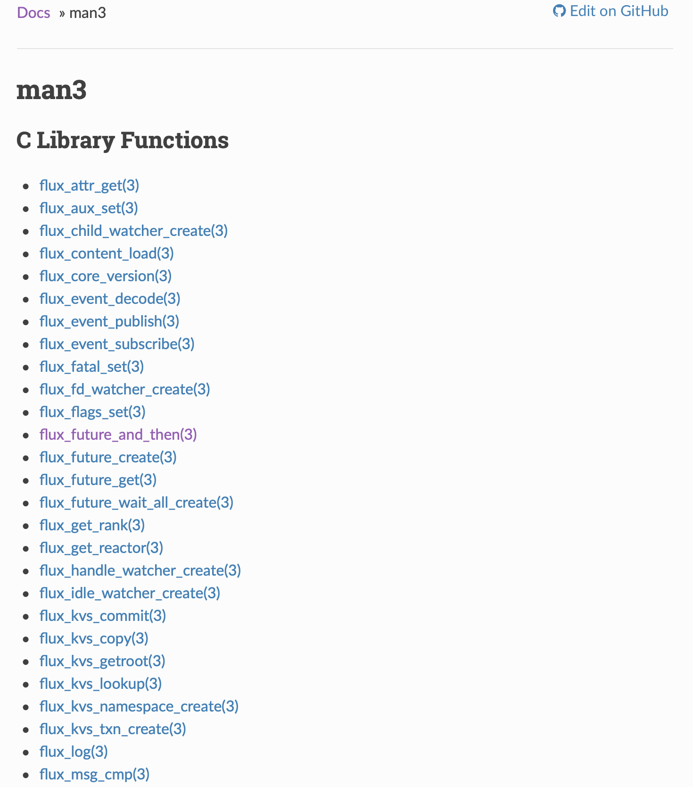
A rich set of well-defined APIs enables easy job coordination and communication.
Jobs in ensemble-based simulations often require close coordination and communication with the scheduler as well as among them.
Traditional CLI-based approach can be slow and cumbersome.
Ad hoc approaches (e.g., many empty files) can lead to many side-effects.
Flux provides well-known communication primitives.
Pub/sub, request-reply, and send-recv patterns
High-level services
Key-value store (KVS) API
Job API (submit, wait, state change notification, etc)
Flux’s APIs are consistent across different platforms
https://flux-framework.readthedocs.io/projects/flux-core/en/latest/index.html

Slide 10
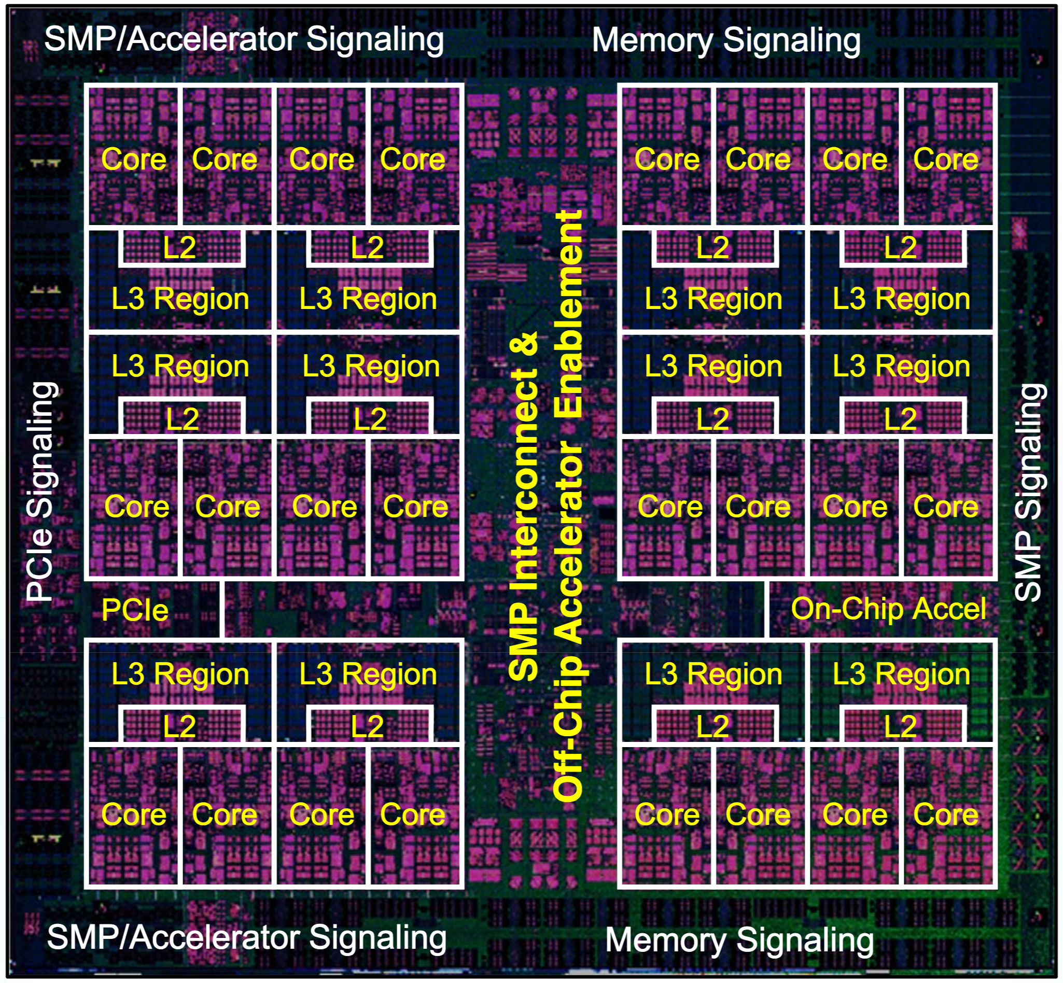

MuMMI: Scheduler specialization addresses co-scheduling and throughput challenges on Sierra.
Integrate Flux into Maestro workflow manager to enqueue and dequeue jobs
ML dynamically determines “most interesting” jobs
Specialize the policy to be non-node-exclusive scheduling for co-scheduling
At least 5 different logically separate jobs, each with CPU and/or GPU requirements on every node
Handle the volume of jobs using two-level hierarchy
Socket 1
Socket 2
CG Run 1
CPU-only Job
(i.e., DDFT, DataBroker, CG Setup)
CG Run 3
In-Situ 1
In-Situ 3
CG Run 2
CG Run 4
In-Situ 2
In-Situ 4

Slide 11
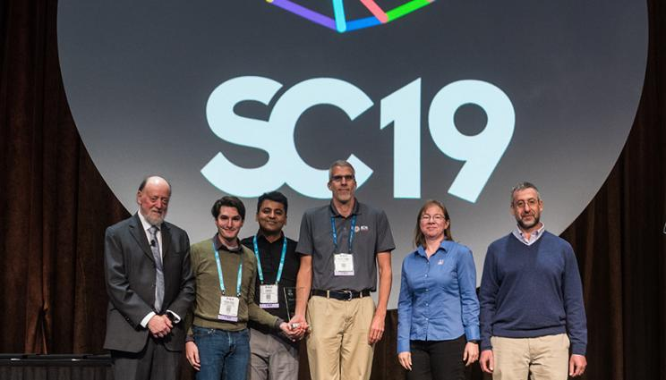
MuMMI has continuously adopted new features of Flux
Flux has expanded its resource management and scheduling feature set
New remote execution service
Fluxion, a graph-based scheduler
Python APIs and our command line interface set
The MuMMI team was one of our co-design partners
Get and incorporate the feedback on our new functionalities and APIs set
Much of this churn has been hidden under Maestro
Maestro continuously updated its Flux Adapter
https://github.com/LLNL/maestrowf/releases/tag/v1.1.7
https://github.com/LLNL/maestrowf/releases/tag/v1.1.6
Major challenges arose when MuMMI was ported ORNL Summit
Their local computing environment is significantly different!
Worked with OCLF support staff to test and install Flux
Updated our documentation (https://flux-framework.readthedocs.io/en/latest/coral.html)
The MuMMI work won the SC19 best paper award!

Slide 12
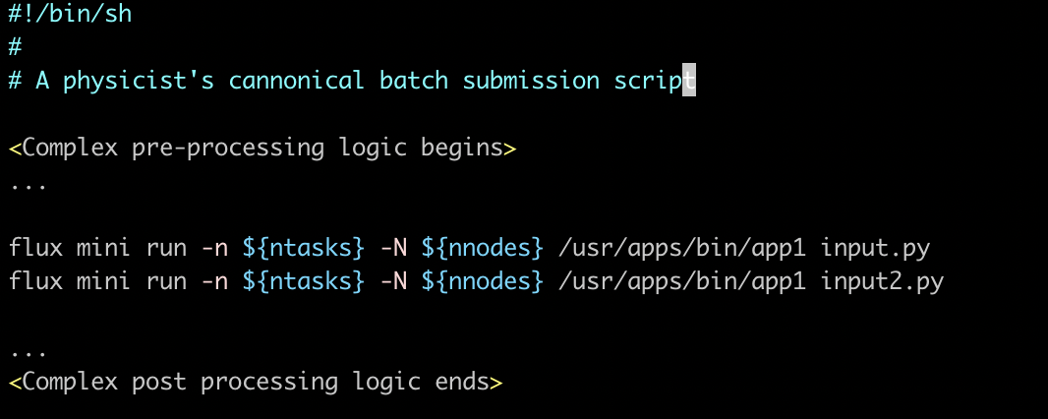
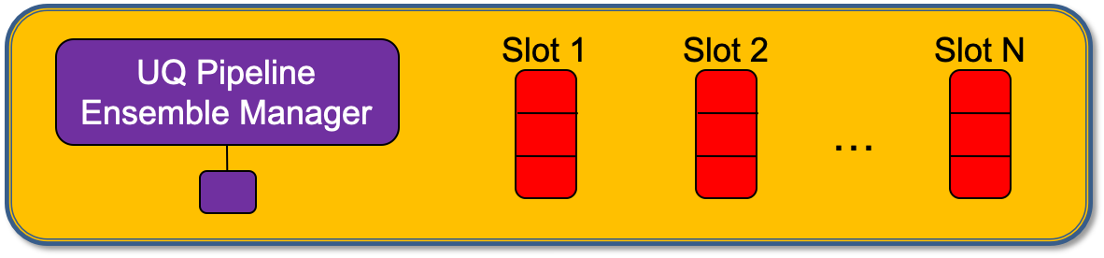
UQPipeline: Seeding an ensemble study has faced well-known problems with no easy solution
Using scientist’s batch script to seed a large ensemble would be ideal, but…
Impose limits on the number of concurrently running job
Getting a resource allocation consisting of N nodes is often much quicker than getting N resource allocations
Tools like UQPipeline (UQP) can provide requisite throughput, but…
Arduous effort to convert their (often complex) batch scripts into the tool’s interface
Must do this for N times for N different tools
James Corbett from the Themis team will discuss
our scheduling-unification approach and lessons-learned at 1:30PM

Slide 13
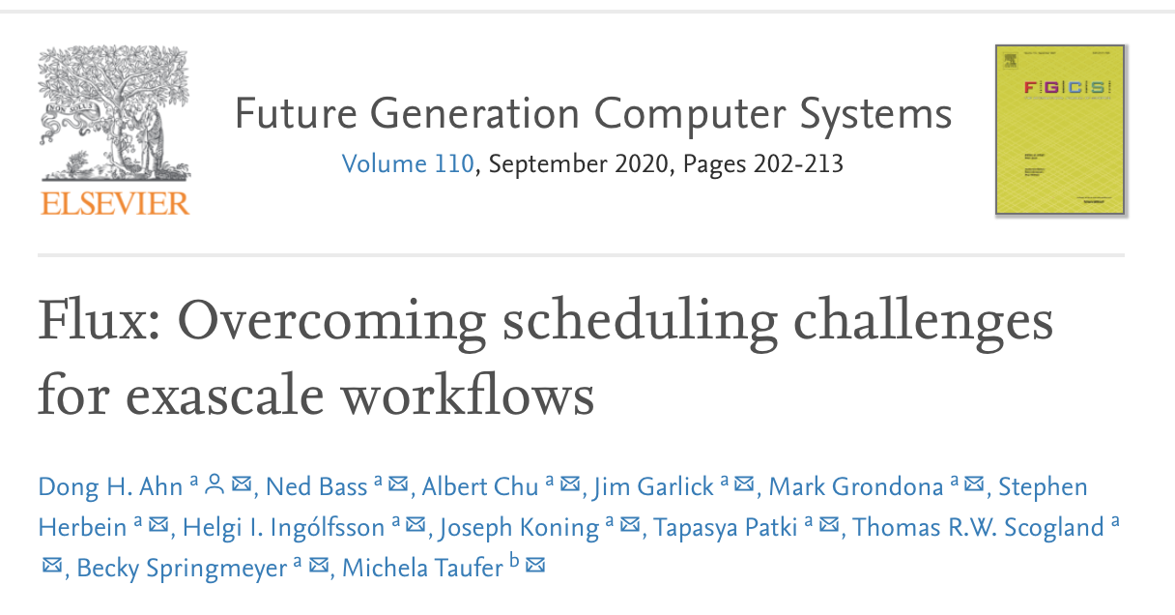
Flux underpins new AI methods to combine simulations with experiments.
Machine Learning Strategic Initiative (MLSI): Initial target was to run 1 billion short-running jobs
Similar needs as MuMMI for co-scheduling heterogenous components
Developed Merlin which uses Flux to address throughput and portability
Merlin used by other workflows: Pf3d and COVID-19 modeling simulation ensemble
New pillar
Machine learning to compare
simulation and experiment
Traditional pillar
high-performance computing
Improved prediction
Deep neural network
HYDRA simulation
NIF X-ray image
Complete simulation and experiment data
Check out our new FGCS journal paper detailing our techniques and results! (https://www.sciencedirect.com/science/article/abs/pii/S0167739X19317169)

Slide 14
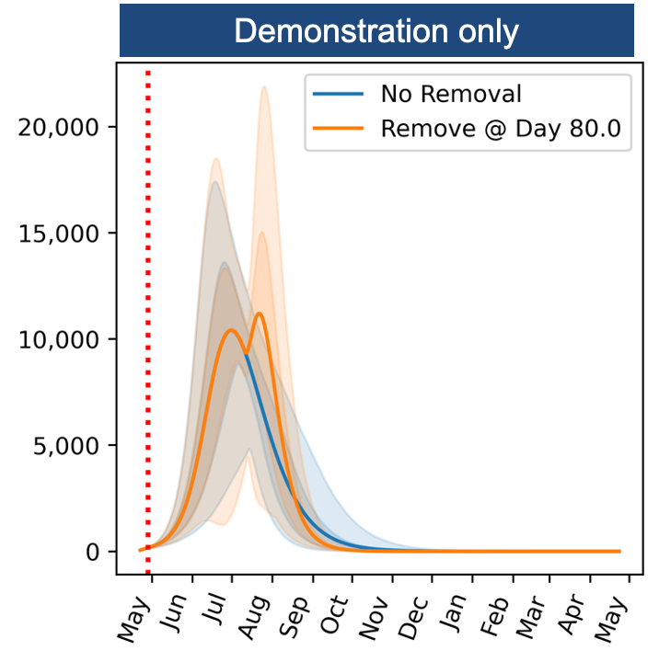
Flux has been providing workflow aid for COVID-19 scenario modeling workflow
Collaboration among LLNL, LANL and NERSC
A large ensemble of EPICAST simulations are employed to model COVID-19 spread patterns
Inform agencies like FEMA of the prediction
If school is open only 2 days a week how differently will COVID-19 spread?
Port Flux to ORNL Summit and NERSC CORI
"With flux, we can model one scenario with UQ for the entire country in ~5 minutes on a few [lassen] nodes: near real-time feedback.” – Luc Peterson
A Demo COVID-19 Scenario Modeling (Credited to Luc Peterson)

Slide 15
Flux has been providing workflow aid for fast ML-based COVID-19 drug molecule design workflow
A COVID-19 drug molecule design multi-disciplinary team formed
Develop a new highly scalable end-to-end drug design workflow
Expediently produce potential COVID-19 drug molecules for the next stages of drug discovery
This team brought together multiple LLNL experts from multiple directorates including PLS, GS, CASC and LC
LBANN (Livermore Big Artificial Neural Network Toolkit) researchers
Focus on developing a scalable training technique
ATOM (Accelerating Therapeutics for Opportunities in Medicine) researchers
Focus on coupling this high-quality ML model with its generative molecular design (GMD) pipeline
Increase the probability to generate new COVID-19 drug molecules with desired properties (e.g., diversity)
ConveyorLC researchers focus on coupling the above with their HPC simulations
Allow for evaluating the docking properties of the newly generated drug candidate molecules
Search for an appropriate ligand that fits both energetically and geometrically the target protein's binding site
Workflow infrastructure researchers devise workflow techniques
Ensure the scalability of this newly envisioned coupled workflow

Slide 16
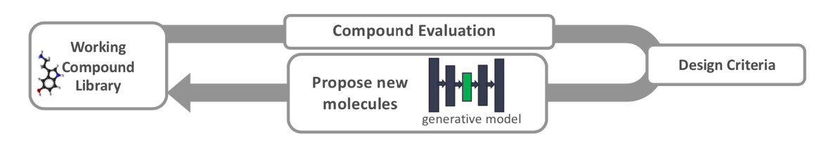
Flux provides a scalable foundation for fast drug discovery workflow, Gordon Bell Covid-19 finalist
Generative molecule antiviral design loop overview.
Scalable machine learning techniques to Improve the quality and reduced the time to produce machine-learned models for use in small molecule antiviral design.
Flux is the scalable backbone of the overall generative drug design pipeline
Compounds are evaluated to optimize for properties, e.g., minimal toxicity.
After each iteration of compound evaluation, compounds in the latent space of the generative model are perturbed to move closer to meeting the design objectives.
The molecules are decoded from the latent space to generate new molecules for evaluation in the next iteration.
As docking and MD simulations are also coupled into this pipeline, the multi-disciplinary design team approached Flux to couple them in a scalable and portable way
https://www.exascaleproject.org/workflow-technologies-impact-sc20-gordon-bell-covid-19-award-winner-and-two-of-the-three-finalists/

Slide 17
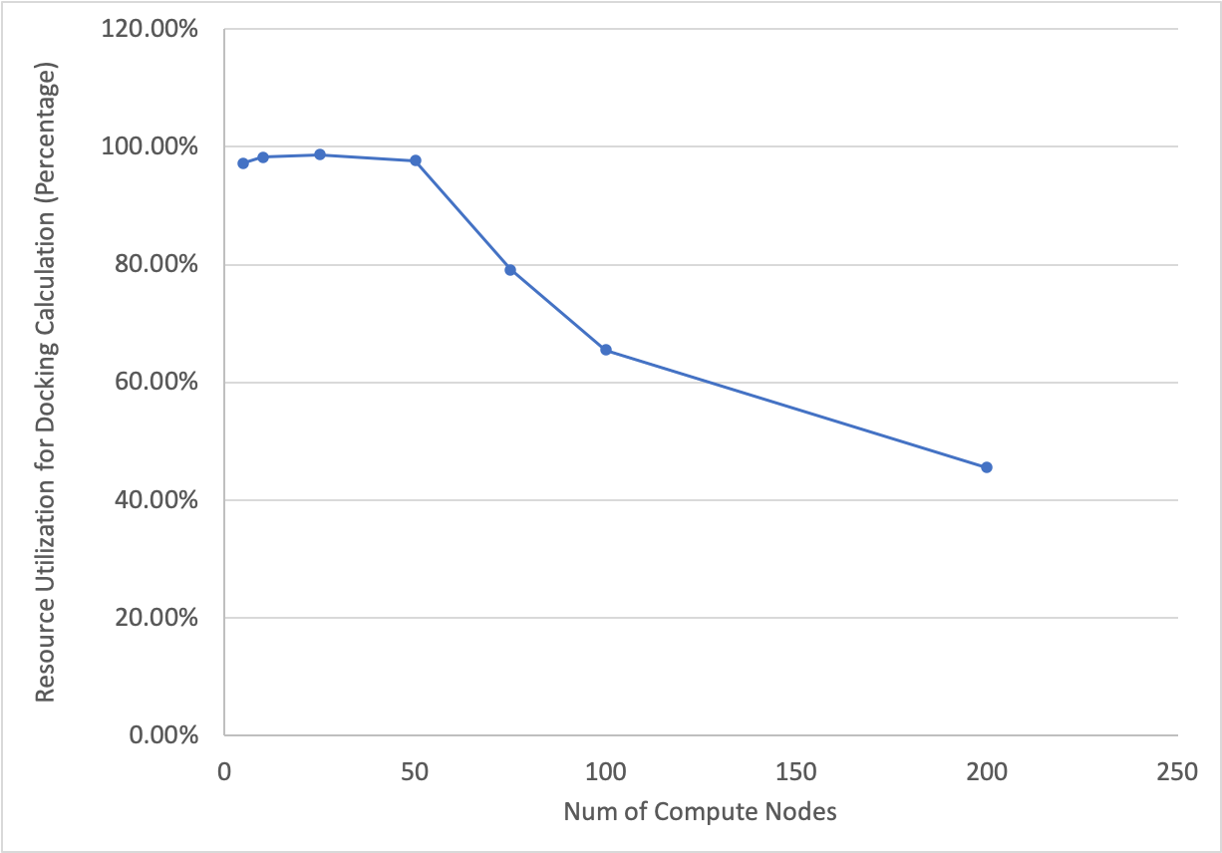
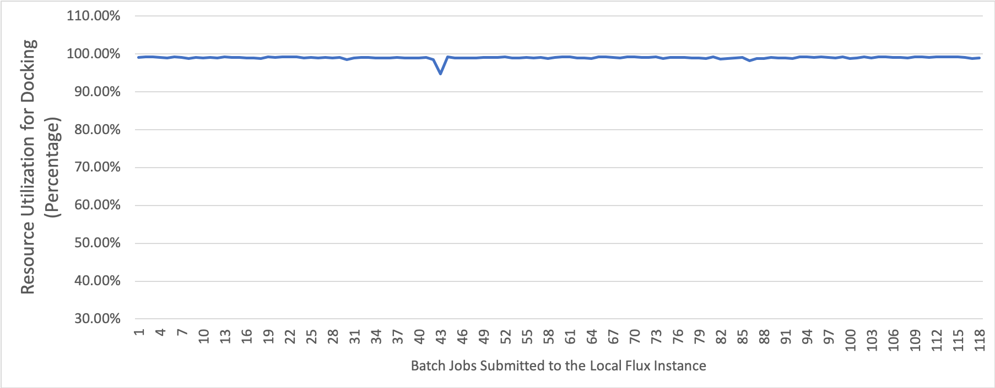
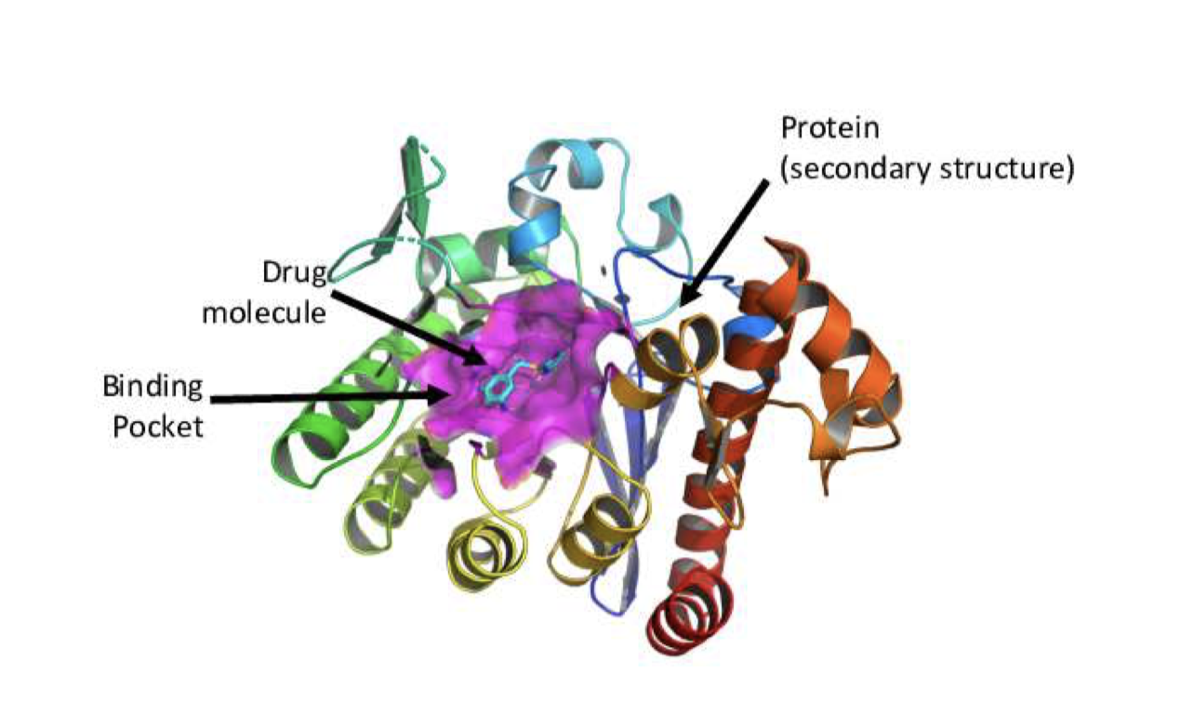
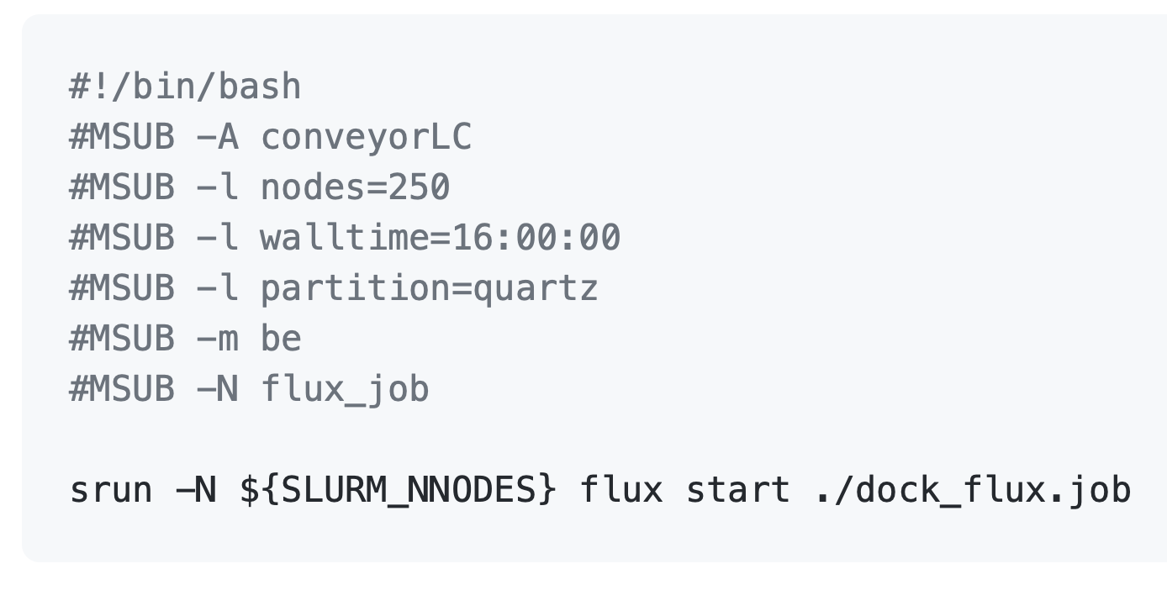
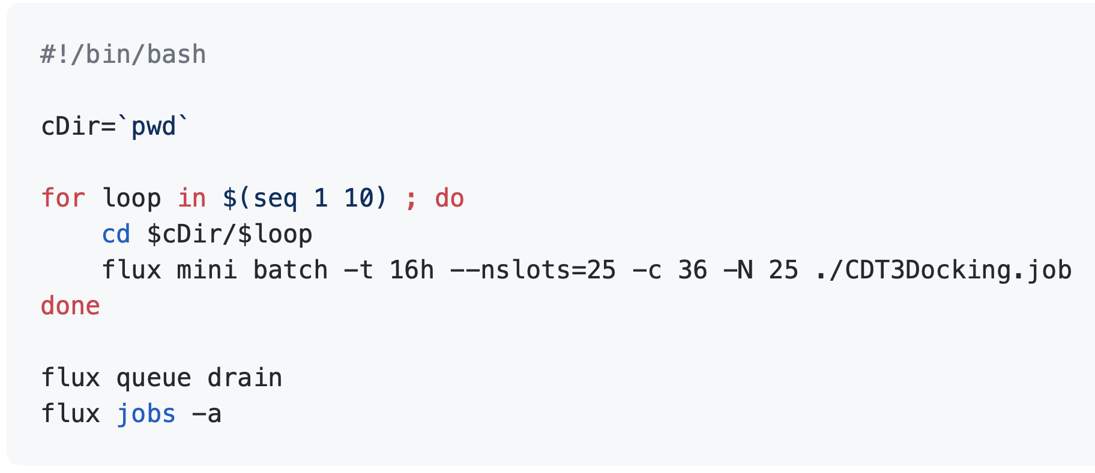
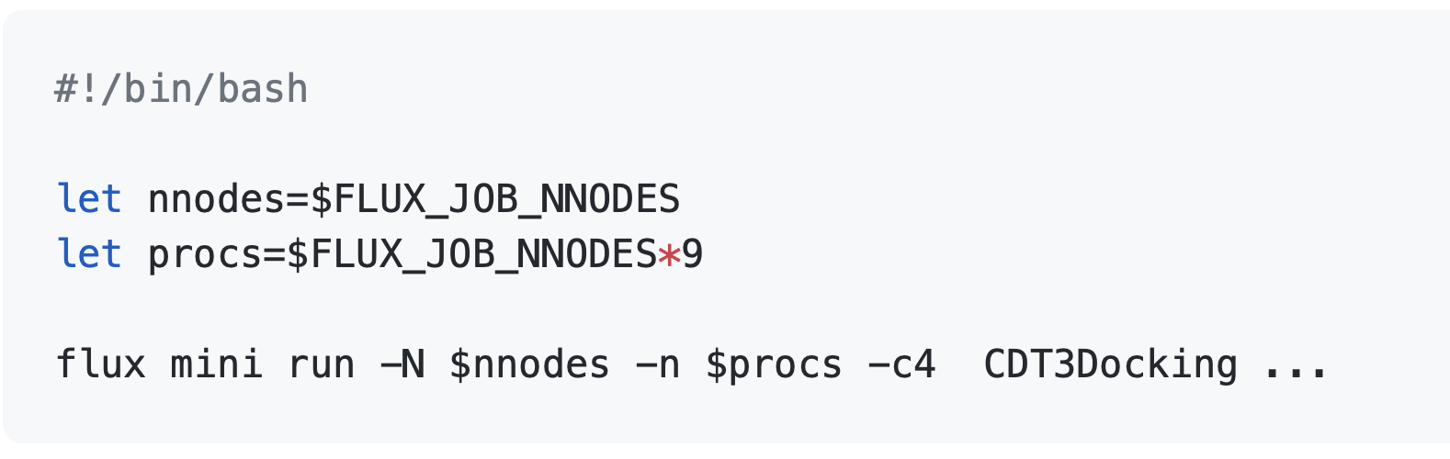
Flux solves two most critical workflow problems in this COVID19 drug molecule design workflow.
Resource Utilization of ConveyorLC
Resource Utilization at 2,950 Quartz Nodes with Flux

Slide 18
Flux is uniquely enabling many modern scientific workflows including COVID-19 problems.
MuMMI workflow (Cancer research)
Has run over several years
Won the SC19 best paper award for its approach that enable a new genre of cancer research
Recently updated their workflow on the latest Flux to gear up for runs on ORNL Summit and others
LLNL’s UQP workflow (UQ and V&V)
Refactored its ensemble manager layer into a standard-alone component by building on Flux
Produced Themis
ECP ExaAM (Advanced additive manufacturing)
4x throughput improvements with 5-line change
MLSI Merlin workflow (Large ML/AI)
Addressed throughput and portability needs
Demonstrated 100 million short running jobs
COVID-19 scenario modeling workflow
Support what-if scenarios on COVID19 spread
“With flux we can model one scenario w/ UQ for the entire country in ~5 minutes on a few [lassen] nodes: near real-time feedback”
Portably ran LLNL, ORNL and NERSC machines
COVID-19 drug design end-to-end workflow
Combine ATOM (ML-based drug molecule design framework) with large docking simulations (ConveyorLC) to expediently produce COVID 19 drug compounds for further clinical testing.
At 256 nodes, Flux improved resource utilization of ConveyorLC by a factor of 2
Making it easy to couple ATOM with ConveyorLC
SC20 COVID-19 Gordon Bell Award finalist:

Slide 19




How can workflow tools cooperate?
Tools
UQPipeline
sina
conduit
codes
Description
UQPipeline
maestro
Orchestration
UQPipeline
maestro
merlin
Resource Allocation
lsf
flux
slurm
Slide from Luc Peterson’s WIP talk on Merlin

Slide 20






LLNL teams have been collaborating with a vision to create a “plug and play” workflow ecosystem.
Merlin Cross-machine dynamic task coordination
flux coordinates work on HPC resources
Maestro Intuitive workflow description
Flux Scalable HPC scheduling
Scientist describes workflow with maestro
Merlin workers pull tasks from server
Merlin sends workflow to
persistent server
Workers on a GPU allocation join the fun
Slide from Luc Peterson’s WIP talk on Merlin

Slide 21
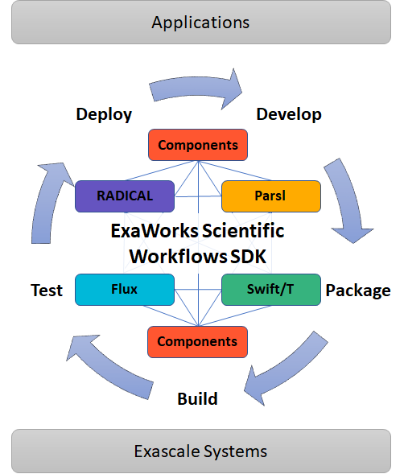
Flux is one of the founding member of ECP ExaWorks to define APIs/methodology to create a plug-N-play component-based ecosystem.
ExaWorks: Provide a production-grade Software Development Kit (SDK) for exascale workflows
Focus is on defining this SDK and common API’s with the workflows community
Implemented at progressively integrated levels
Level 0: Technologies can be packaged together
Level 1: Break down vertical silos and leverage capabilities via component interfaces or pairwise integrations
Level 2: Community developed and supported component APIs
Approach:
Community policy to ensure minimum standard software quality practices for reliable deployment and use (modeled on E4S)
Integrate community workflows libraries/tools in the SDK and develop pair-wise integrations
Engage an open community-based design process
Ensure scalability of components on Exascale Systems
Check out our breakout slides on “The ExaWorks Workflows SDK Project” presented yesterday at 1PM – 2:30PM!
(https://whova.com/portal/webapp/ecpan_202104/Agenda/1510949)

Slide 22
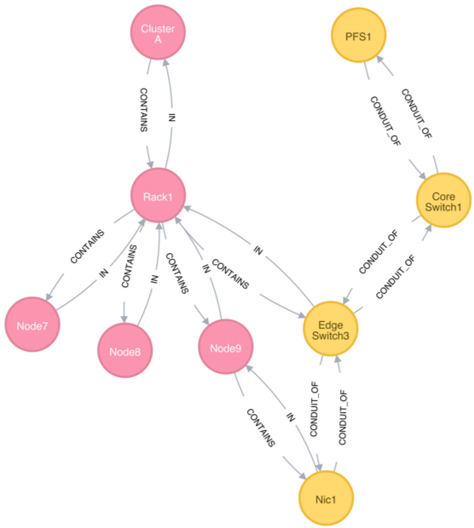
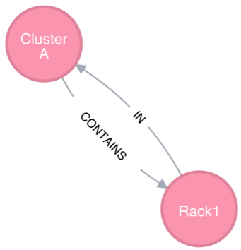
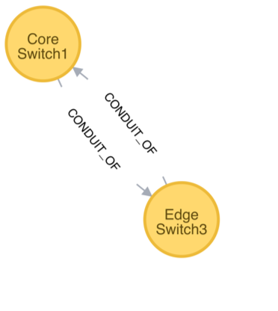
Fluxion uses a graph-based resource data model to represent schedulable resources and their relationships.
The traditional resource data models are largely ineffective to cope with the resource challenge
Designed when the systems are much simpler
Node-centric models
A graph consists of a set of vertices and edges
Highly composable to support a graph with arbitrary complexity
The scheduler remains to be a highly generic graph code.
Containment subsystem
Network connectivity subsystem

Slide 23


Fluxion has proven effective in scheduling diverse resources such as exascale multi-tiered storage and cloud resources
Co-designing of multi-tiered storage with HPE for El Cap is under way
Starting a 3-way partnership with RedHat OpenShift and IBM T.J. Watson teams
Use Fluxion as the driver to define Kubernete’s standard scheduler interface
IBM already developed KubeFlux prototype
Position Flux for all four tenets of HPC+Cloud convergence
Check out our SC20 state-of-the-practice talk video: “Current and Future Converged Cloud-HPC Workflows at LLNL”
Loosely coupled cloud and HPC (in use today)
Hybrid/bursting to public cloud
HPC-in-cloud: HPC RJMS in K8s; workflows scale everywhere
Cloud-in-HPC: K8s in RJMS
Check out our breakout slides on “Converging on a Unified Scheduling and Management Framework for HPC and Cloud Tasks” presented this morning at 10AM – 11:30AM (https://whova.com/portal/webapp/ecpan_202104/Agenda/1511029)

Slide 24
Fully Hierarchical Scheduling and Job Interfaces for Large Ensembles of Uncertainty Quantification (UQ) Tasks
Flux Tutorial at ECP Annual Meeting, April 14, 2020
James Corbett
Acknowledgment: Ned Bass, Subhendu Behera, Albert Chu, Kyle Chard, Brandon Cook, James Corbett, Ryan Day, Franc Di Natalie, David Domyancic, Phil Eckert, Stephen Herbein, Jim Garlick, Elsa Gonsiorowski, Mark Grondona, Helgi Ingolfsson, Shantenu Jha, Zvonko Kaiser, Dan Laney, Carlos Eduardo Gutierrez, Edgar Leon, Don Lipari, Daniel Milroy, Joseph Koning, Claudia Misale, Chris Moussa, Frank Muller, Tapasya Patki, Yoonho Park, Luc Peterson, Barry Rountree, Thomas R. W. Scogland, Becky Springmeyer, Michela Taufer, Jae-Seung Yeom, Veronica Vergara and Xiaohua Zhang

Slide 25
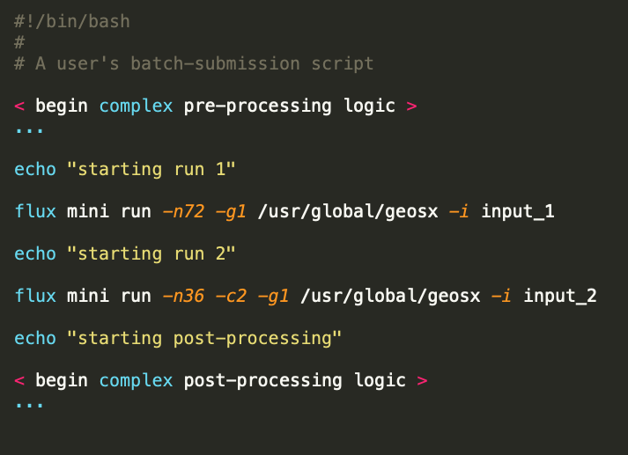
An Old Problem: Running Batch Jobs in Parallel
Traditional HPC resource managers are great for small numbers of large jobs.
Want to run a geophysics simulation across 500 nodes? Easy:
Write a batch script and submit it.
Want to run 500 geophysics simulations across 500 nodes? Not so easy. Could submit 500 batch jobs, but:
Some resource managers impose limits on the number of concurrently running jobs.
Some HPC centers, like ANL and ORNL, prioritize large jobs.
Difficult to keep track of so many jobs.

Slide 26
Flux’s Hierarchical Scheduling: A Natural Solution
When users want to submit large numbers of jobs, the usual solution is to use a workflow manager.
A good solution, but has significant start-up cost. User must:
Learn how to use the workflow manager.
Translate their batch script logic into the language of the workflow manager.
Flux’s hierarchical scheduling features provide a natural solution.
Request one 500-node allocation and painlessly, dynamically partition it into 1-node allocations.
Most resource managers cannot subdivide resource allocations.
For instance, Slurm has two levels: sbatch gets you an allocation, and srun inside an allocation launches a parallel task.
Calling sbatch from inside an allocation gets you an entirely separate allocation.
Allocation from sbatch/salloc
srun
srun
srun
The Slurm hierarchy
Flux Instance
Flux Instance
Flux Instance
Flux Instance
Flux
Flux
Flux
Flux
Flux
Flux
One possible Flux hierarchy

Slide 27
Hierarchical Scheduling + Workflow Managers
With Flux’s hierarchical scheduling, users don’t need to make any changes to their batch scripts.
For more advanced use-cases, users can combine workflow managers and hierarchical scheduling.
LLNL’s Themis and Merlin already build in support for hierarchical scheduling
LLNL’s Themis uses Flux’s hierarchical scheduling for two purposes:
Provide a simple, streamlined interface to running batch jobs in parallel
Maximize scaling and performance by multiplying the number of available schedulers
Though new, the Themis-Flux integration has already made an impact on multiple LLNL research projects.

Slide 28
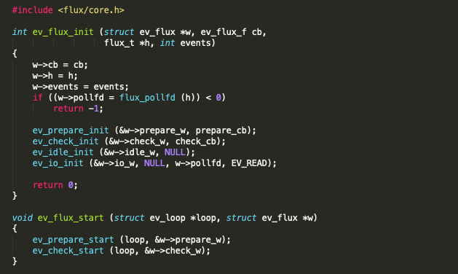
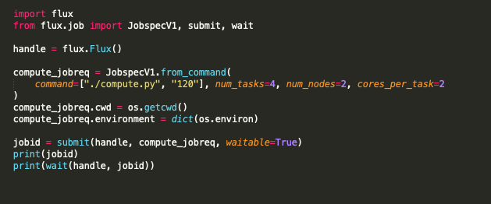
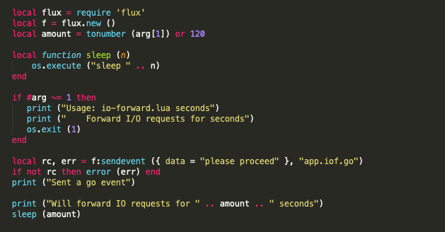
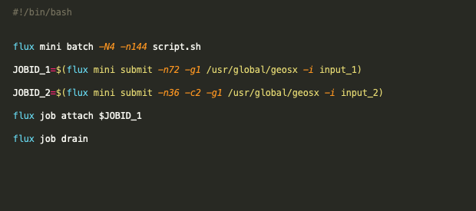
The Four Interfaces to Flux
The Python Library
The C Library
The Command-Line Interface
The Lua Library
Notes:
Now I want to transition to talking about a problem that will affect any workflow manager that wants to interact with Flux---namely, how do you actually use Flux?
Flux currently has four interfaces: C, Python, and Lua libraries, and a command-line interface. The C library is the primary interface---the other interfaces are all wrappers around it.
In the world of workflow managers, though, the Python library is very popular, since so many workflow managers are written in Python, and are probably what are used the most overall. I will be focusing entirely on the Python library.

Slide 29
Flux’s Python Library
Like the underlying C library, Flux’s Python library follows a callback-heavy event loop model.
For instance, to submit a job and get the job ID, the basics steps are:
Call Flux’s submit function with a job description and get a future representing the ID of the job.
Attach a callback to the future.
Enter Flux’s event loop, and the callback will be triggered when the ID is ready.
The event loop is not thread-safe.
Many Flux objects (like futures) cannot be shared across threads.
The model can be a burden on workflow managers that want to use a different model, or that need to support other resource managers.
Notes:
Examples of such workflow managers: Parsl, LLNL’s Themis, Merlin?
To use Flux’s library, many workflow managers were forced to use Flux’s extremely slow synchronous functions, or to build a lot of code on top of Flux like:
Adding threads of their own
Occasionally polling Flux’s event loop

Slide 30
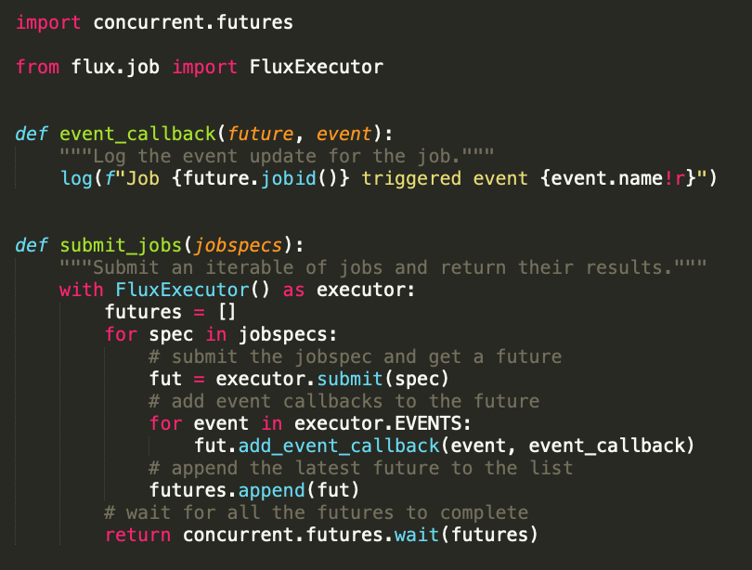
FluxExecutor: Hiding the Event Loop
The FluxExecutor extension to Flux’s Python library provides a simple multithreading interface that completely hides Flux’s event loop.
Almost perfectly compatible with Python’s concurrent.futures standard library.
Submit a job to FluxExecutor, and you get a future representing the completion of the job and all its state changes.
FluxExecutor still deals in futures and callbacks, but futures are fulfilled (and callbacks are invoked) by other threads.
Calling threads (i.e. user threads) never need to block on anything.
Eleven lines of code to submit a collection of jobs, log their event updates, and collect their results.
Notes:
Users can continuously feed jobs to FluxExecutor

Slide 31
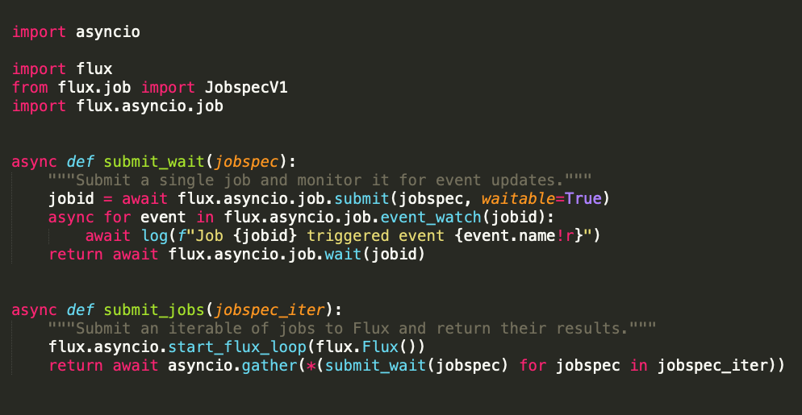
Coming Soon: Flux-Asyncio Integration
Hides Flux’s event loop behind async/await syntax.
Users see no futures or callbacks.
Flux’s event loop runs automatically when there is work to do, without burdening the Asyncio event loop unnecessarily.
Ten lines of code to submit a collection of jobs, log their event updates, and collect their results.
Notes:
A new feature that was very recently added to Flux’s Python library was asyncio integration. For those who aren’t familiar, asyncio is a library shipped with Python 3 for writing concurrent code, especially network-IO-bound code. By using async/await syntax, users can write code that looks and feels as if it was synchronous.
This new extension to Flux’s python bindings integrates Flux’s and asyncio’s event loops. Flux’s event loop and callbacks are completely hidden from the user.
Flux’s event loop isn’t written out of existence---it’s still there in the background. But the Flux event loop only runs when there is real work to do, never blocking asyncio for a long period of time. In fact, based on some recent performance tests, the asyncio implementation is one of the fastest ways to interact with Flux.

Slide 32
References
Python’s concurrent.futures library: https://docs.python.org/3/library/concurrent.futures.html
Python’s asyncio library: https://docs.python.org/3/library/asyncio.html
Flux’s Python documentation: https://flux-framework.readthedocs.io/projects/flux-core/en/latest/python/modules.html
Example usage of Flux’s Python bindings: https://flux-framework.readthedocs.io/projects/flux-workflow-examples/en/latest/index.html

Slide 33
Flux’s Resource & Job Model
Flux Tutorial at ECP Annual Meeting, April 14, 2020
Stephen Herbein
Acknowledgment: Dong H. Ahn, Ned Bass, Subhendu Behera, Albert Chu, Kyle Chard, Brandon Cook, James Corbett, Ryan Day, Franc Di Natalie, David Domyancic, Phil Eckert, Stephen Herbein, Jim Garlick, Elsa Gonsiorowski, Mark Grondona, Helgi Ingolfsson, Shantenu Jha, Zvonko Kaiser, Dan Laney, Carlos Eduardo Gutierrez, Edgar Leon, Don Lipari, Daniel Milroy, Joseph Koning, Claudia Misale, Chris Moussa, Frank Muller, Tapasya Patki, Yoonho Park, Luc Peterson, Barry Rountree, Thomas R. W. Scogland, Becky Springmeyer, Michela Taufer, Jae-Seung Yeom, Veronica Vergara and Xiaohua Zhang

Slide 34
The changes in resource types are equally challenging.
Problems are not just confined to the workload/workflow challenge.
Resource types and their relationships are also becoming increasingly complex.
Much beyond compute nodes and cores...
GPGPUs
Burst buffers
I/O and network bandwidth
Network locality
Power
PFS BW Capacity

Slide 35
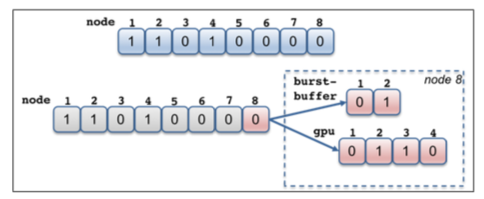
The traditional resource data models are largely ineffective to cope with the resource challenge.
Designed when the systems are much simpler
Node-centric models
SLURM: bitmaps to represent a set of compute nodes
PBSPro: a linked-list of nodes
HPC has become far more complex
Evolutionary approach to cope with the increased complexity
E.g., add auxiliary data structures on top of the node-centric data model
Can be quickly unwieldy
Every new resource type requires new a user-defined type
A new relationship requires a complex set of pointers cross-referencing different types.

Slide 36
Flux uses a graph-based resource data model to represent schedulable resources and their relationships.
A graph consists of a set of vertices and edges
Vertex: a resource
Edge: a relationship between two resources
Highly composable to support a graph with arbitrary complexity
The scheduler remains to be a highly generic graph code.
Containment subsystem
Network connectivity subsystem
Notes:
As long as you can represent your system with our graph format, our scheduler can scheduling it, with no changes to our graph code
Example: resource disaggregation?? And the rabbits

Slide 37
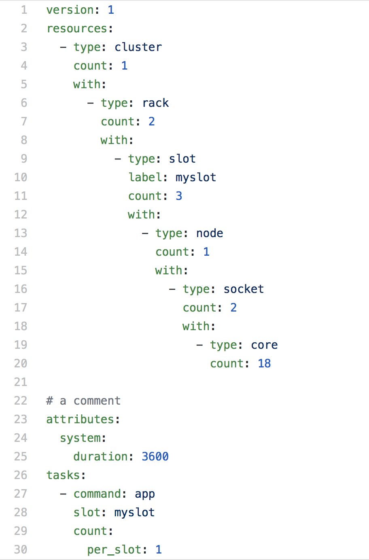
Flux’s graph-oriented canonical job-spec allows for a highly expressive resource requests specification.
Graph-oriented resource requirements
Express the resource requirements of a program to the scheduler
Express program attributes such as arguments, run time, and task layout, to be considered by the execution service
cluster->racks[2]->slot[3]->node[1]->sockets[2]->core[18]
slot is the only non-physical resource type
Represent a schedulable place where program process or processes will be spawned and contained
Referenced from the tasks section

Slide 38
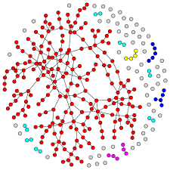
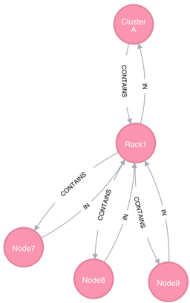
Flux maps our complex scheduling problems into graph matching problems.
Traverse, match and score

Slide 39
We use graph filtering and pruned searching to manage the graph complexity and optimize our graph search.
The total graph can be quite complex
Two techniques to manage the graph complexity and scalability
Filtering reduces graph complexity
The graph model needs to support schedulers with different complexity
Provide a mechanism by which to filter the graph based on what subsystems to use
Pruned search increases scalability
Fast RB tree-based planner is used to implement a pruning filter per each vertex.
Pruning filter keeps track of summary information (e.g., aggregates) about subtree resources.
Scheduler-driven pruning filter update
Containment+Network
Containment
Filtering
Prune filter tracks available node count in aggregate at the subtree
Pruning

Slide 40
Tiered Storage in HPC
CN
CN
CN
SSD
SSD
SSD
CN
CN
CN
64x
SSD
SSD
SSD
CN
CN
CN
SSD
SSD
SSD
BB
ION
BB
SSD
SSD
SSD
SSD
12x
13x
SSD
SSD
IB
5x
Parallel File System
Source: Lucy Nowell (DOE)
We can use the Flux graph scheduler to allocate these new storage tiers with 0 code changes
SSD
SSD
SSD
SSD
SSD
Notes:
TODO: make sure to say that the most advanced version of this is for El Capitan and their rabbit subsystem. Didn’t have to change any code, just use the existing graph code.

Slide 41
Performance Variation-Aware Scheduling
Implement a variation-aware match policy plugin with Flux’s graph scheduler
Goal: minimize the difference in perf classes within a job
2.47x difference between the slowest/fastest node for MG
1.91x difference for LULESH.
Idea: capture deterministic variation by statically grouping nodes into performance classes
Flux’s graph-based resource model easily and effectively enables this variation-aware scheduler optimization

Slide 42
Cloud Bursting
Hierarchical Scheduling works for bursting: cloud is just another level
traditional schedulers not designed for resource dynamism
often hard to add new relationships without scheduler modification/restart
elastic resource addition/removal are graph operations
Check out our breakout slides on “Converging on a Unified Scheduling and Management Framework for HPC and Cloud Tasks” (https://whova.com/portal/webapp/ecpan_202104/Agenda/1511029)

Slide 43
Play The Full Game!
Flux Tutorial at ECP Annual Meeting, April 14, 2020
Dan Milroy
Acknowledgment: Dong H. Ahn, Ned Bass, Subhendu Behera, Albert Chu, Kyle Chard, Brandon Cook, James Corbett, Ryan Day, Franc Di Natalie, David Domyancic, Phil Eckert, Stephen Herbein, Jim Garlick, Elsa Gonsiorowski, Mark Grondona, Helgi Ingolfsson, Shantenu Jha, Zvonko Kaiser, Dan Laney, Carlos Eduardo Gutierrez, Edgar Leon, Don Lipari, Daniel Milroy, Joseph Koning, Claudia Misale, Chris Moussa, Frank Muller, Tapasya Patki, Yoonho Park, Luc Peterson, Barry Rountree, Thomas R. W. Scogland, Becky Springmeyer, Michela Taufer, Jae-Seung Yeom, Veronica Vergara and Xiaohua Zhang

Slide 44
Hand—on Session
Flux Tutorial at ECP Annual Meeting, April 14, 2020
Stephen Herbein & Tapasya Patki
Acknowledgment: Dong H. Ahn, Ned Bass, Subhendu Behera, Albert Chu, Kyle Chard, Brandon Cook, James Corbett, Ryan Day, Franc Di Natalie, David Domyancic, Phil Eckert, Stephen Herbein, Jim Garlick, Elsa Gonsiorowski, Mark Grondona, Helgi Ingolfsson, Shantenu Jha, Zvonko Kaiser, Dan Laney, Carlos Eduardo Gutierrez, Edgar Leon, Don Lipari, Daniel Milroy, Joseph Koning, Claudia Misale, Chris Moussa, Frank Muller, Tapasya Patki, Yoonho Park, Luc Peterson, Barry Rountree, Thomas R. W. Scogland, Becky Springmeyer, Michela Taufer, Jae-Seung Yeom, Veronica Vergara and Xiaohua Zhang

Slide 45
Accessing the Hands-On Demo
Run locally with Docker:
docker run –ti –p 8888:8888 fluxrm/ecp-tutorial:2021
This image will be available in perpetuity
Using our EC2 instances
ssh ecpuser@ecp-X.herbein.dev
Ping the chat for your value of X
Password (for ssh and jupyter notebook): 2021fluxecp
These instances will disappear shortly after the tutorial ends
In the next section, we will help you get things running on your own cluster!

Slide 46
Bring Your Own Cluster (BYOC): Testing Flux on your clusters
Flux Tutorial at ECP Annual Meeting, April 14, 2020
All
Acknowledgment: Dong H. Ahn, Ned Bass, Subhendu Behera, Albert Chu, Kyle Chard, Brandon Cook, James Corbett, Ryan Day, Franc Di Natalie, David Domyancic, Phil Eckert, Stephen Herbein, Jim Garlick, Elsa Gonsiorowski, Mark Grondona, Helgi Ingolfsson, Shantenu Jha, Zvonko Kaiser, Dan Laney, Carlos Eduardo Gutierrez, Edgar Leon, Don Lipari, Daniel Milroy, Joseph Koning, Claudia Misale, Chris Moussa, Frank Muller, Tapasya Patki, Yoonho Park, Luc Peterson, Barry Rountree, Thomas R. W. Scogland, Becky Springmeyer, Michela Taufer, Jae-Seung Yeom, Veronica Vergara and Xiaohua Zhang

Slide 47
Disclaimer
This document was prepared as an account of work sponsored by an agency of the United States government. Neither the United States government nor Lawrence Livermore National Security, LLC, nor any of their employees makes any warranty, expressed or implied, or assumes any legal liability or responsibility for the accuracy, completeness, or usefulness of any information, apparatus, product, or process disclosed, or represents that its use would not infringe privately owned rights. Reference herein to any specific commercial product, process, or service by trade name, trademark, manufacturer, or otherwise does not necessarily constitute or imply its endorsement, recommendation, or favoring by the United States government or Lawrence Livermore National Security, LLC. The views and opinions of authors expressed herein do not necessarily state or reflect those of the United States government or Lawrence Livermore National Security, LLC, and shall not be used for advertising or product endorsement purposes.

